Slide 1
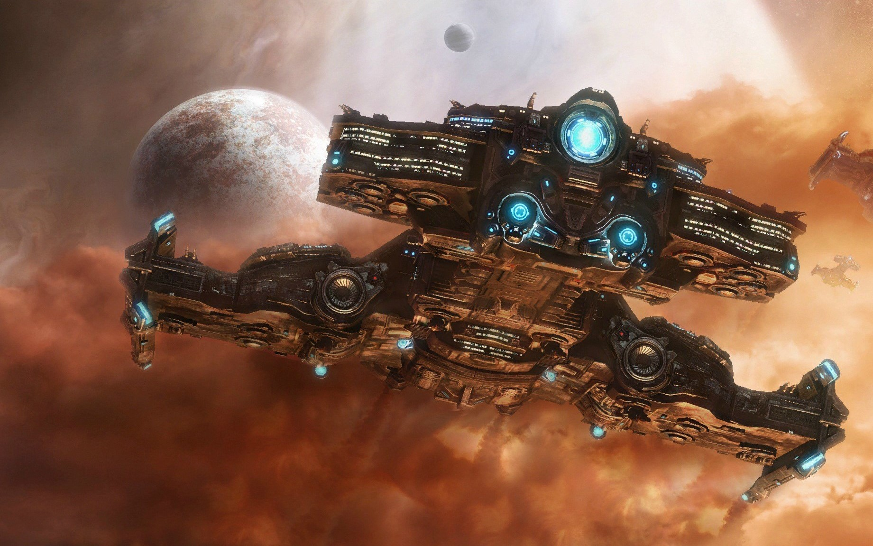
StarCraft II Bot Final
TEAM MEMBER:
WANG, ZHENGYI ZHANG, YUCHENG
DING, XIAOJIE ZHOU, BOCONG
ZHANG, YILONG LIANG, YUANG

Slide 2
Catalogue
Introduction
Overview of Game
Current Game We Play
Methodology
Behavior Tree
CNN
Q-learning
Result & Analysis
Demo
Win Rate
Future Work

Slide 3
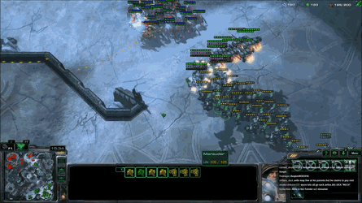
Introduction
About the Game
RTS Game
Main aim is to destroy All of Opponent’s Structures
Three Races: Protoss, Terran, Zerg
Difficulties of Our Project
Too many choices
How to make decision
large training data
Excepted Results

Slide 4
Current Game
Map: Simple 128
Full Technology Tree
Enabled war fog
Mirror Matching

Slide 5
Methodology
Behavior Tree
Convolutional Neural Network
Q-learning
Deep Q-Network
Notes:
想放这么一张图 但Google好像不支持 要去本地PPT做

Slide 6

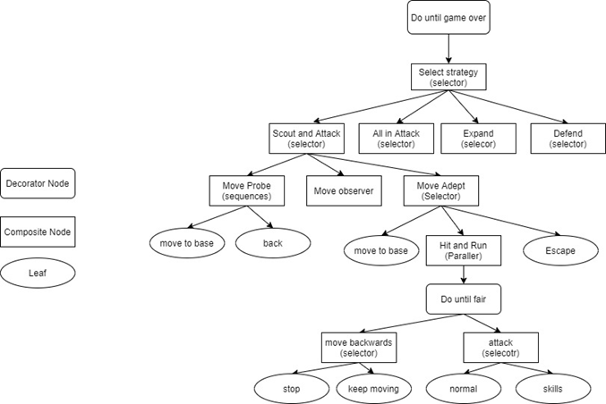
Methodology
Behavior Tree
A tree structure framework
Traversal the entire tree in level order
Three kinds of node
Composite Nodes
Decorator Nodes
Action Nodes
Reduce the burden of machine learning
Imitate classic strategy
Notes:
As we mentioned before, although we wanted to create a full data-driven self-learning agent, we could not afford such large compute load. So, we used behavior tree imitating classic strategy to control the main work flow and then used machine learning methods such as CNN, Q-learning to accuracy control the threshold of each action. A behavior tree is a tree structure framework and composites by three kinds of node. The controller will traversal the entire tree in level order and then performs the corresponding nodes.
Right side picture is part of our behavior tree.

Slide 7
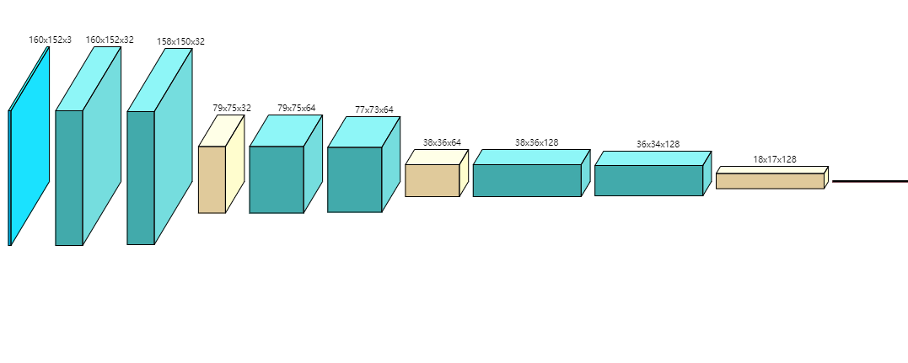
Basic CNN
Max pooling 1
Max pooling 2
Conv5
Conv6
Max pooling 3
Flatten +
Dense
Input
Conv1
Conv2
Conv3
Conv4

Slide 8
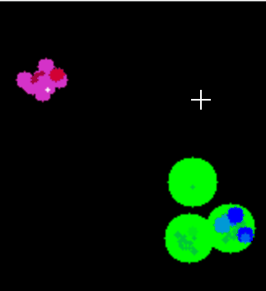
Training Dataset
Supervised Learning
Input include:
Position (structure, unit…)
Population (worker, army…)
Resource (minerals, gas…)
Output include 4 actions:
On standby
Attack the nearest unit
Attack enemy buildings
Attack enemy base

Slide 9
Methodology
Q-Learning
Structure:
States: 1D array of size 8
Actions: Tuple of size 12
Q table: Calculated q value for each state and action pair
Training: 600 games against very easy AI & easy AI
Win rate(100 games):
96% against very easy AI
26% against easy AI
Challenges:
Scalability
Complexity

Slide 10
Methodology
DQN with Feedforward NN
Structure:
Input: 1D array of size 8
Decision Neural Network: Used for making ingame decision
Learning Neural Network: Used for training weights
Experience Replay: Store past experiences - (S_{t}, a_{t}, r, S_{t+1})
Hyperparameters:
Batch Size: 32
Learning frequency: Train learning NN at the end of every game
Merge frequency: Every 50 games
Training:
400 games again very easy AI

Slide 11
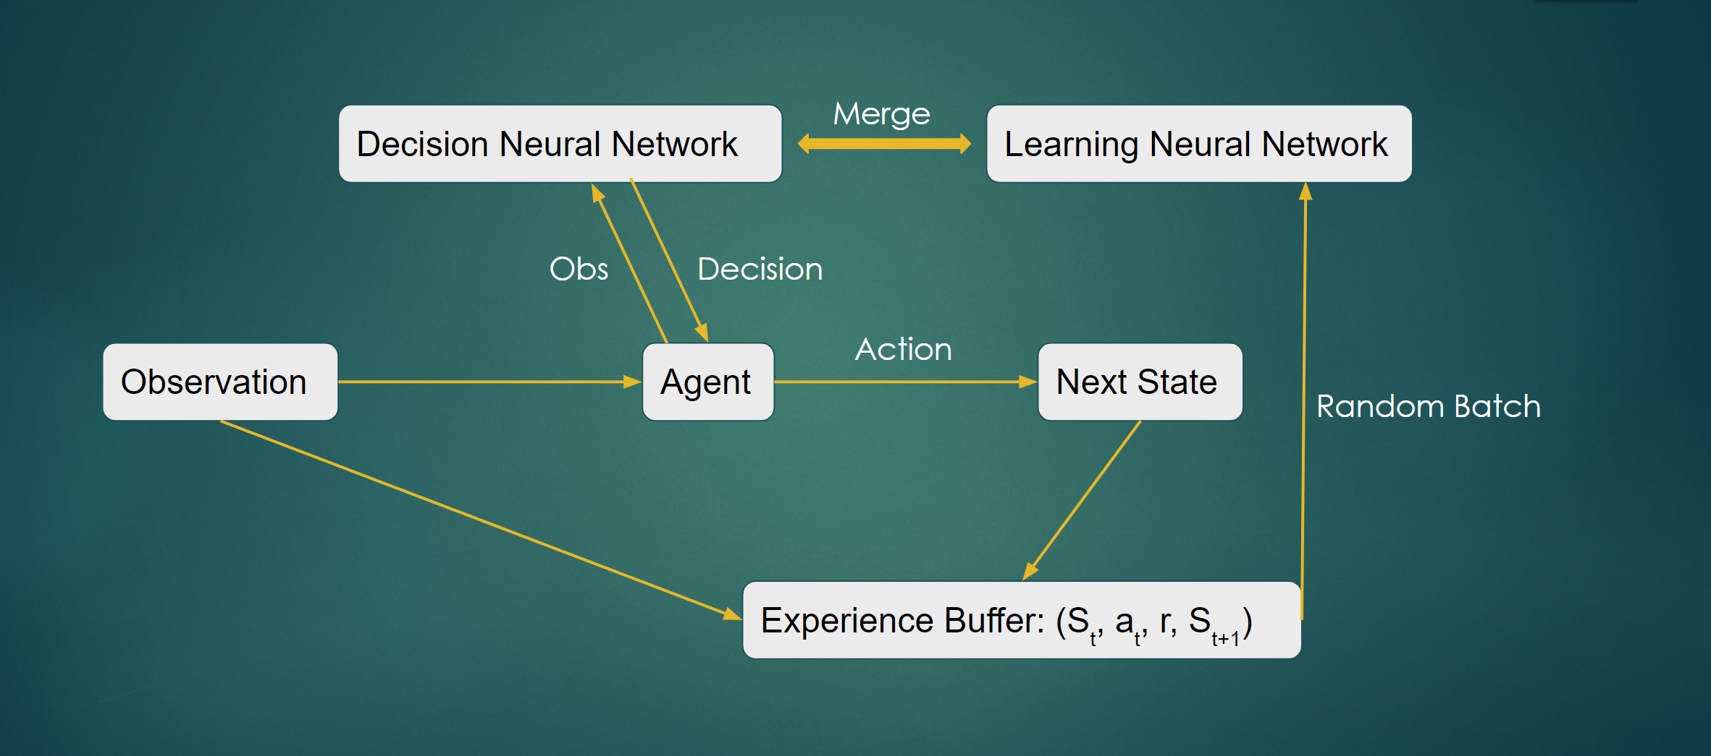
DQN Structure

Slide 12
Methodology
DQN with CNN
Structure:
Input: Images of size (64 x 64 x 3)
Decision NN and Learning NN are both convolutional neural network
Experience Replay: Store past experiences - (S_{t}, a_{t}, r, S_{t+1})
Hyperparameters:
Batch Size: 32
Learning frequency: Train learning NN at the end of every game
Merge frequency: Every 30 games
Training:
500 games again very easy AI

Slide 13
Results Analysis
Improvement
Q-Learning
Improved result with better state representation
Refined actions to further improve performance
DQN
Input changed from 1D array to images representing game state
CNN
Features Design
Tuning Structure & Hyperparameters
Behavior Tree
Coarse-Grained “Action”
E.g. Behavior Tree for Harass in SCII

Slide 14
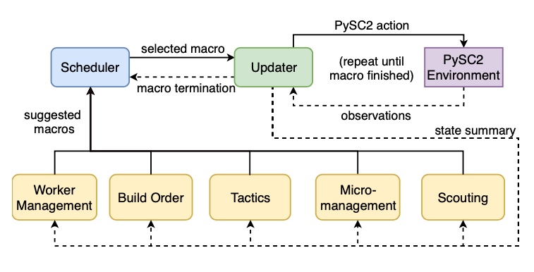
Next Step
Combination
Try to Combine Different Parts within Modular Architecture
Scheduler
Select “Macro”
Updater
“Macro” to “Micro”
Env Observation
Ref: https://arxiv.org/abs/1811.03555
Notes:
The architecture splits responsibilities between multiple modules that each control one aspect of the game, such as build-order selection or tactics.
A centralized scheduler reviews macros strategies suggested by all modules and decides their order of execution.
An updater keeps track of environment changes and instantiates macros into series of executable actions.
Because Modules in this framework can be optimized independently or jointly via human design, planning, or reinforcement learning.
We can combine them

Slide 15
Demo
https://youtu.be/WbMoaGDJh4E
https://drive.google.com/file/d/1iWq6LP822zH_EFJsW0jfhE6gFfTE0jKE/view?usp=sharing

Slide 16


